Slide 1
Applied Cryptography hash-and-sign, ElGamal signature, Schnorr signature, digital signature algorithm
Liangfeng Zhang
School of Information Science and Technology
ShanghaiTech University

Slide 2
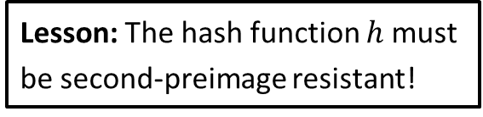

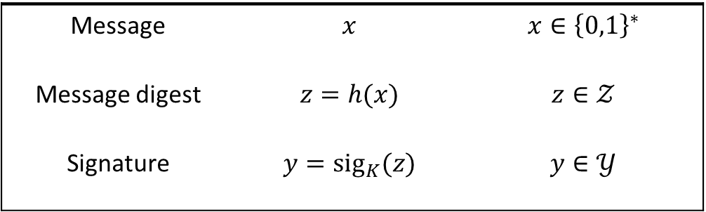

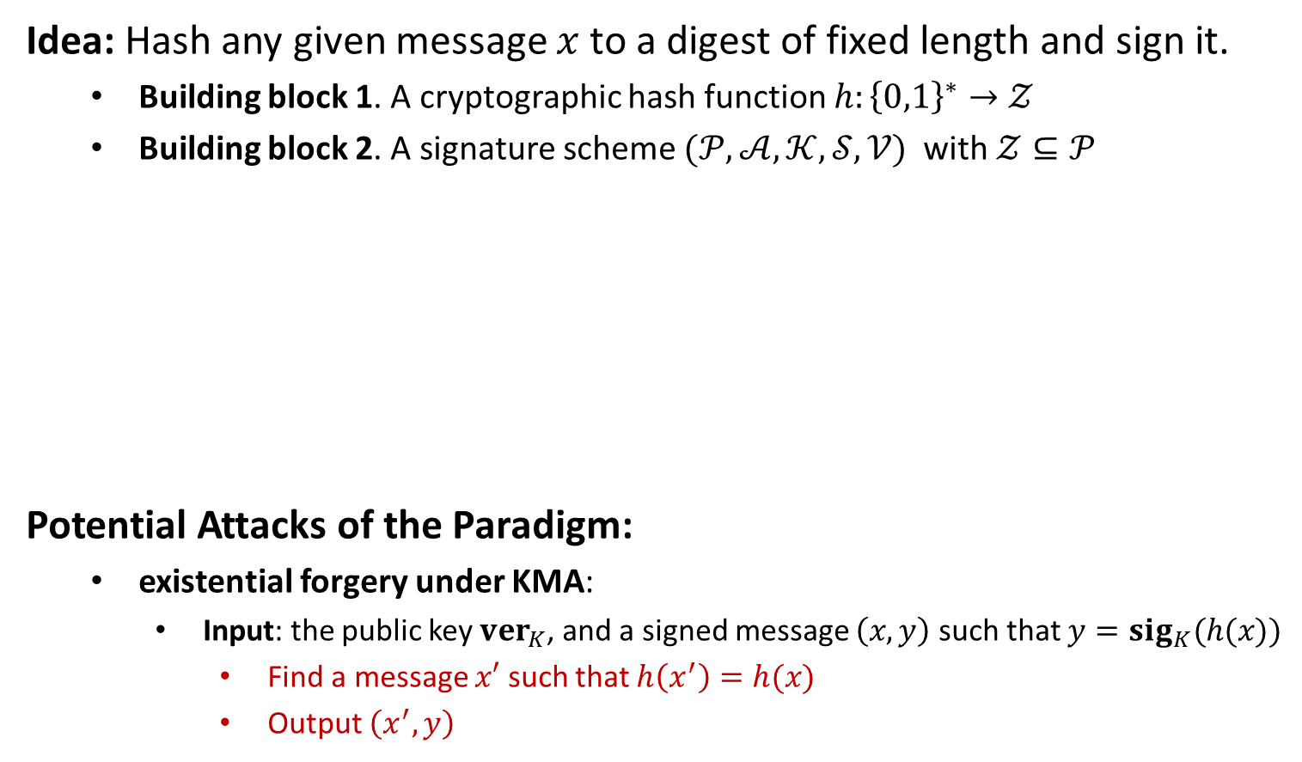
Hash-and-Sign Paradigm
Idea: Hash any given message $x$ to a digest of fixed length and sign it.
Building block 1. A cryptographic hash function $h:{\left\{0,1\right\}}^{∗}→𝒵$
Building block 2. A signature scheme $(𝒫,𝒜,𝒦,𝒮,𝒱)$ with $𝒵⊆𝒫$
Potential Attacks of the Paradigm:
existential forgery under KMA:
Input: the public key $ver_{K}$, and a signed message $\left(x,y\right)$ such that $y={sig}_{K}(h(x))$
Find a message $x′$ such that $h\left(x^{′}\right)=h(x)$
Output $\left(x^{′},y\right)$
Message | $$x$$ | $$x∈{\left\{0,1\right\}}^{∗}$$
Message digest | $$z=h(x)$$ | $$z∈𝒵$$
Signature | $$y=sig_{K}(z)$$ | $$y∈𝒴$$
$$↓$$
$$↓$$
Lesson: The hash function $h$ must be second-preimage resistant!

Slide 3
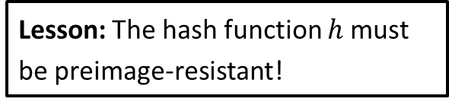
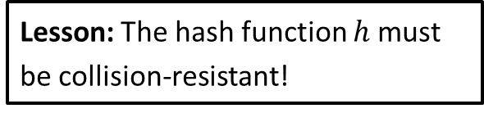
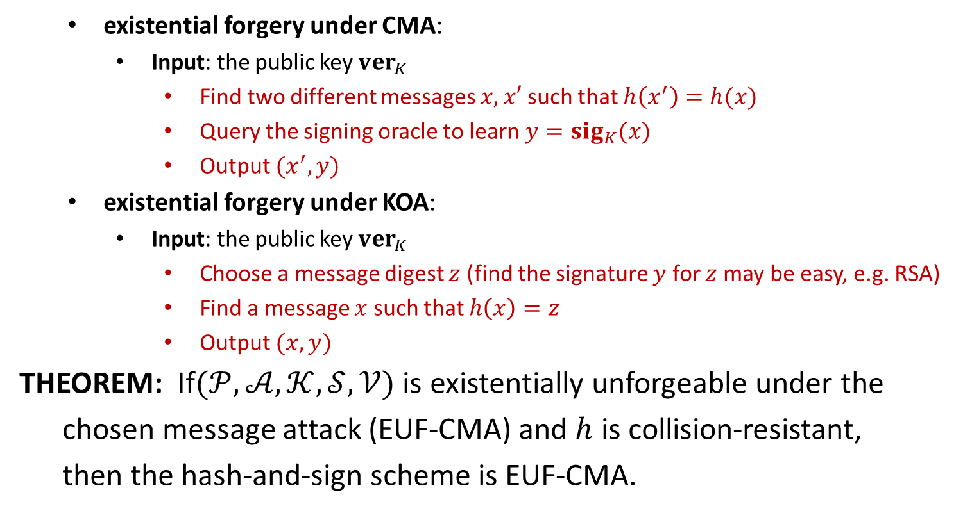
Hash-and-Sign Paradigm
existential forgery under CMA:
Input: the public key $ver_{K}$
Find two different messages $x,x′$ such that $h\left(x^{′}\right)=h(x)$
Query the signing oracle to learn $y={sig}_{K}(x)$
Output $(x^{′},y)$
existential forgery under KOA:
Input: the public key $ver_{K}$
Choose a message digest $z$ (find the signature $y$ for $z$ may be easy, e.g. RSA)
Find a message $x$ such that $h\left(x\right)=z$
Output $(x,y)$
THEOREM: If$(𝒫,𝒜,𝒦,𝒮,𝒱)$ is existentially unforgeable under the
chosen message attack (EUF-CMA) and $h$ is collision-resistant,
then the hash-and-sign scheme is EUF-CMA.
Lesson: The hash function $h$ must be collision-resistant!
Lesson: The hash function $h$ must be preimage-resistant!

Slide 5
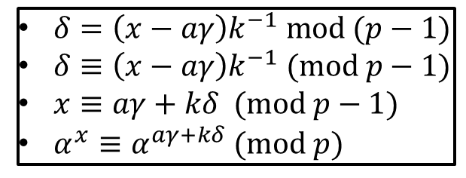
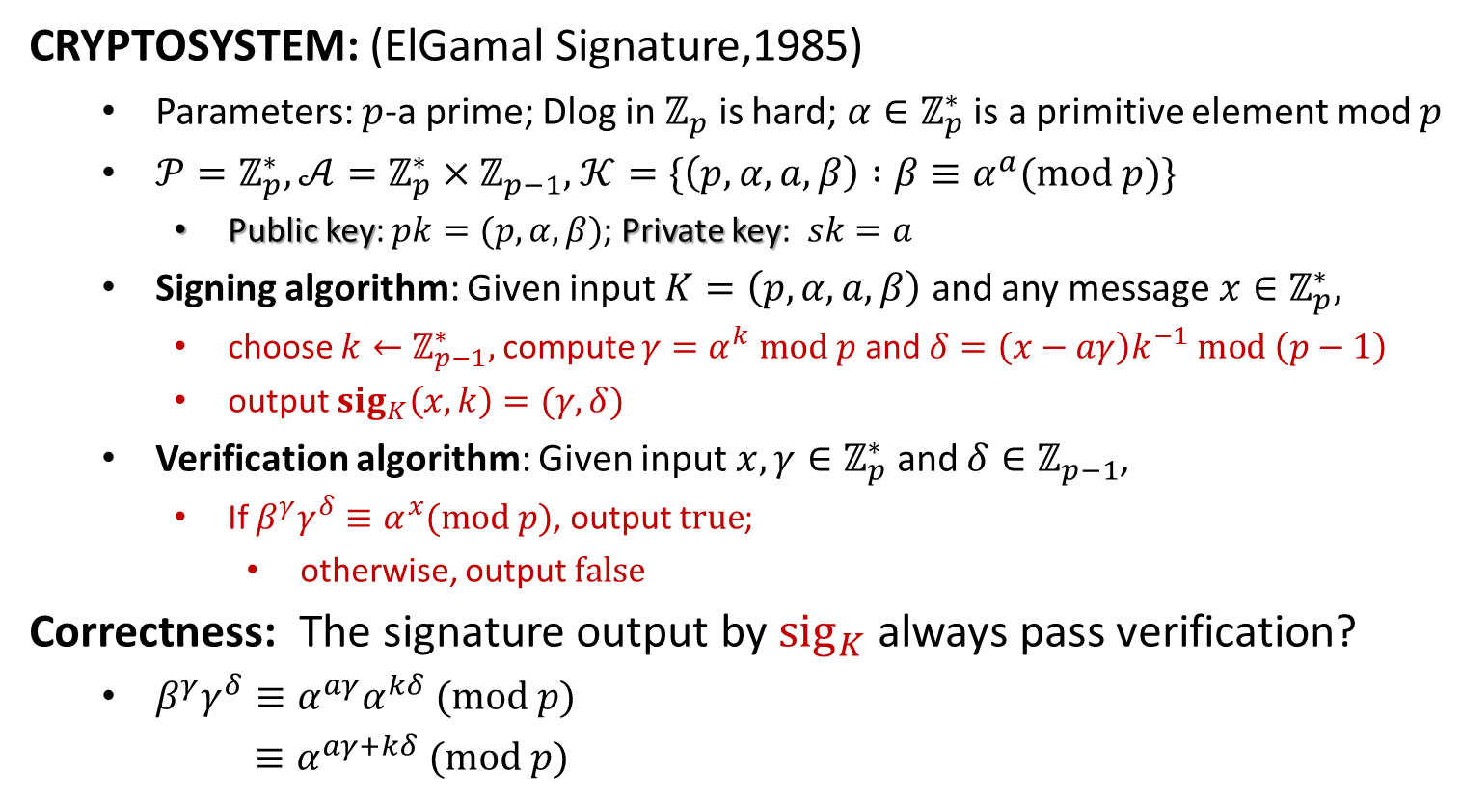
ElGamal Signature
CRYPTOSYSTEM: (ElGamal Signature,1985)
Parameters: $p$-a prime; Dlog in $ℤ_{p}$ is hard; $α∈ℤ_{p}^{∗}$ is a primitive element mod $p$
$𝒫=ℤ_{p}^{∗}, 𝒜=ℤ_{p}^{∗}×ℤ_{p−1},$ $𝒦=\{\left(p,α,a,β\right) :β≡α^{a}(mod p)\}$
Public key: $pk=(p,α,β)$; Private key: $sk=a$
Signing algorithm: Given input $K=\left(p,α,a,β\right)$ and any message $x∈ℤ_{p}^{∗},$
choose $k←ℤ_{p−1}^{∗},$ compute $γ=α^{k} mod p$ and $δ=\left(x−aγ\right)k^{−1} mod \left(p−1\right)$
output $sig_{K}\left(x,k\right)=(γ,δ)$
Verification algorithm: Given input $x,γ∈ℤ_{p}^{∗}$ and $δ∈ℤ_{p−1}$,
If $β^{γ}γ^{δ}≡α^{x}(mod p)$, output $true$;
otherwise, output $false$
Correctness: The signature output by $sig_{K}$ always pass verification?
$β^{γ}γ^{δ}≡α^{aγ}α^{kδ} (mod p)$
$≡α^{aγ+kδ} (mod p)$
$δ=\left(x−aγ\right)k^{−1} mod (p−1)$
$δ≡\left(x−aγ\right)k^{−1} (mod p−1)$
$x≡aγ+kδ (mod p−1)$
$α^{x}≡α^{aγ+kδ} (mod p)$

Slide 6
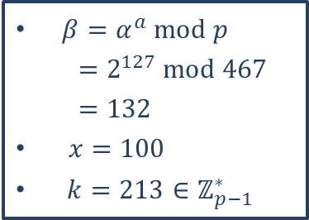
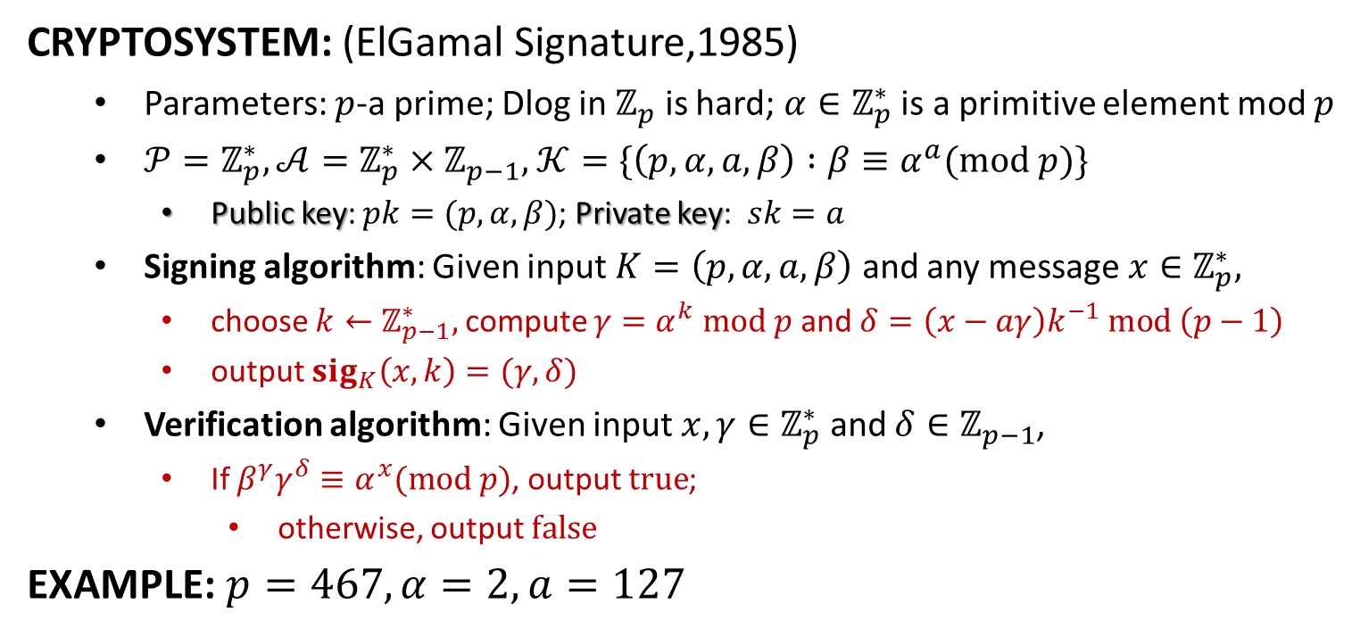

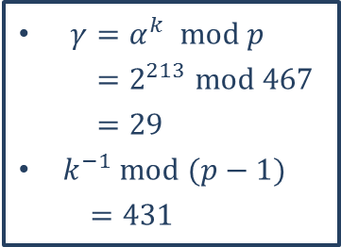
ElGamal Signature
CRYPTOSYSTEM: (ElGamal Signature,1985)
Parameters: $p$-a prime; Dlog in $ℤ_{p}$ is hard; $α∈ℤ_{p}^{∗}$ is a primitive element mod $p$
$𝒫=ℤ_{p}^{∗}, 𝒜=ℤ_{p}^{∗}×ℤ_{p−1},$ $𝒦=\{\left(p,α,a,β\right) :β≡α^{a}(mod p)\}$
Public key: $pk=(p,α,β)$; Private key: $sk=a$
Signing algorithm: Given input $K=\left(p,α,a,β\right)$ and any message $x∈ℤ_{p}^{∗},$
choose $k←ℤ_{p−1}^{∗},$ compute $γ=α^{k} mod p$ and $δ=\left(x−aγ\right)k^{−1} mod \left(p−1\right)$
output $sig_{K}\left(x,k\right)=(γ,δ)$
Verification algorithm: Given input $x,γ∈ℤ_{p}^{∗}$ and $δ∈ℤ_{p−1}$,
If $β^{γ}γ^{δ}≡α^{x}(mod p)$, output $true$;
otherwise, output $false$
EXAMPLE: $p=467, α=2, a=127$
$δ=\left(x−aγ\right)k^{−1} mod p−1$
$=\left(100−127∗29\right)∗431 mod 466$
$=51$
The signature is $(29,51)$
$β^{γ}γ^{δ} mod p={132}^{29}{29}^{51} mod 467$
$=189$
$α^{x} mod p=2^{100} mod 467$
$=189$
$β=α^{a} mod p$
$=2^{127} mod 467$
$=132$
$x=100$
$k=213∈ℤ_{p−1}^{∗}$
$γ=α^{k} mod p$
$=2^{213} mod 467$
$=29$
$k^{−1} mod (p−1)$
$=431$

Slide 7
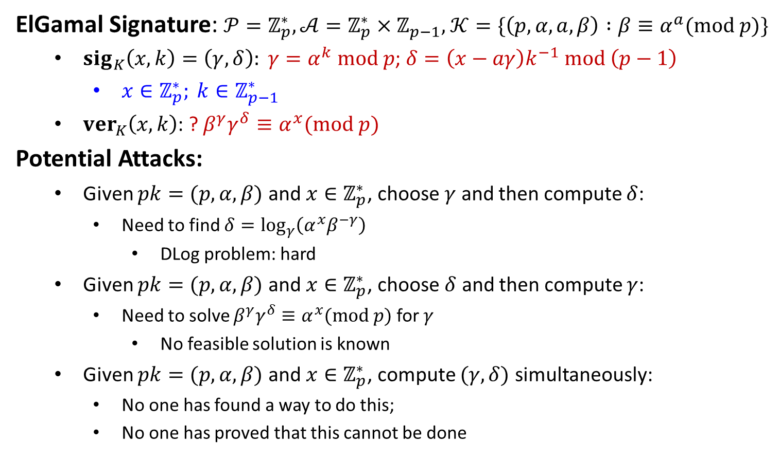
Security
ElGamal Signature: $𝒫=ℤ_{p}^{∗}, 𝒜=ℤ_{p}^{∗}×ℤ_{p−1},$ $𝒦=\{\left(p,α,a,β\right) :β≡α^{a}(mod p)\}$
$sig_{K}\left(x,k\right)=\left(γ,δ\right): γ=α^{k} mod p$; $δ=\left(x−aγ\right)k^{−1} mod \left(p−1\right)$
$x∈ℤ_{p}^{∗}; k∈ℤ_{p−1}^{∗}$
$ver_{K}\left(x,k\right)$: ? $β^{γ}γ^{δ}≡α^{x}(mod p)$
Potential Attacks:
Given $pk=(p,α,β)$ and $x∈ℤ_{p}^{∗}$, choose $γ$ and then compute $δ$:
Need to find $δ=\log_{γ}\left(α^{x}β^{−γ}\right)$
DLog problem: hard
Given $pk=(p,α,β)$ and $x∈ℤ_{p}^{∗}$, choose $δ$ and then compute $γ$:
Need to solve $β^{γ}γ^{δ}≡α^{x}(mod p)$ for $γ$
No feasible solution is known
Given $pk=(p,α,β)$ and $x∈ℤ_{p}^{∗}$, compute $(γ,δ)$ simultaneously:
No one has found a way to do this;
No one has proved that this cannot be done

Slide 8

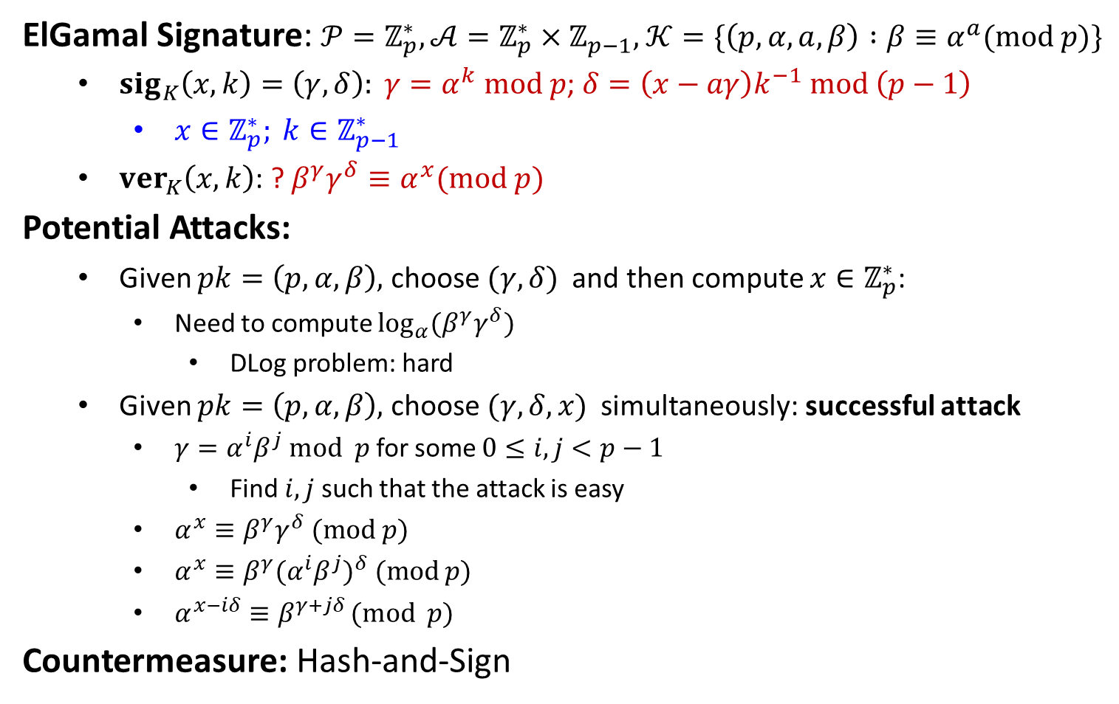

Security
ElGamal Signature: $𝒫=ℤ_{p}^{∗}, 𝒜=ℤ_{p}^{∗}×ℤ_{p−1},$ $𝒦=\{\left(p,α,a,β\right) :β≡α^{a}(mod p)\}$
$sig_{K}\left(x,k\right)=\left(γ,δ\right): γ=α^{k} mod p$; $δ=\left(x−aγ\right)k^{−1} mod \left(p−1\right)$
$x∈ℤ_{p}^{∗}; k∈ℤ_{p−1}^{∗}$
$ver_{K}\left(x,k\right)$: ? $β^{γ}γ^{δ}≡α^{x}(mod p)$
Potential Attacks:
Given $pk=\left(p,α,β\right),$ choose $(γ,δ)$ and then compute $x∈ℤ_{p}^{∗}$:
Need to compute $\log_{α}{(β^{γ}γ^{δ})}$
DLog problem: hard
Given $pk=\left(p,α,β\right),$ choose $(γ,δ,x)$ simultaneously: successful attack
$γ=α^{i}β^{j} mod p$ for some $0≤i,j<p−1$
Find $i,j$ such that the attack is easy
$α^{x}≡β^{γ}γ^{δ} (mod p)$
$α^{x}≡β^{γ}{(α^{i}β^{j})}^{δ} (mod p)$
$α^{x−iδ}≡β^{γ+jδ }(mod p)$
Countermeasure: Hash-and-Sign
$p=467, α=2, β=132$
$i=99, j=179$
$γ=2^{99}{132}^{179} mod p=117$
$j^{−1} mod \left(p−1\right)=151$
$δ=−117⋅151 mod 466=41$
$x=99⋅41 mod 466=331$
$\left(x,γ,δ\right)=\left(331, 117, 41\right)$
${132}^{117}{117}^{41}≡2^{331} \left(mod p\right)$
$x−iδ≡0 (mod p−1)$
$γ+jδ≡0 (mod p−1)$
choose $i,j∈\{0,1,…,p−2\}$
$γ=α^{i}β^{j} mod p$
$δ=−γj^{−1} mod (p−1)$
$x=iδ mod (p−1)$

Slide 10
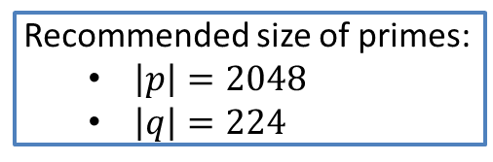
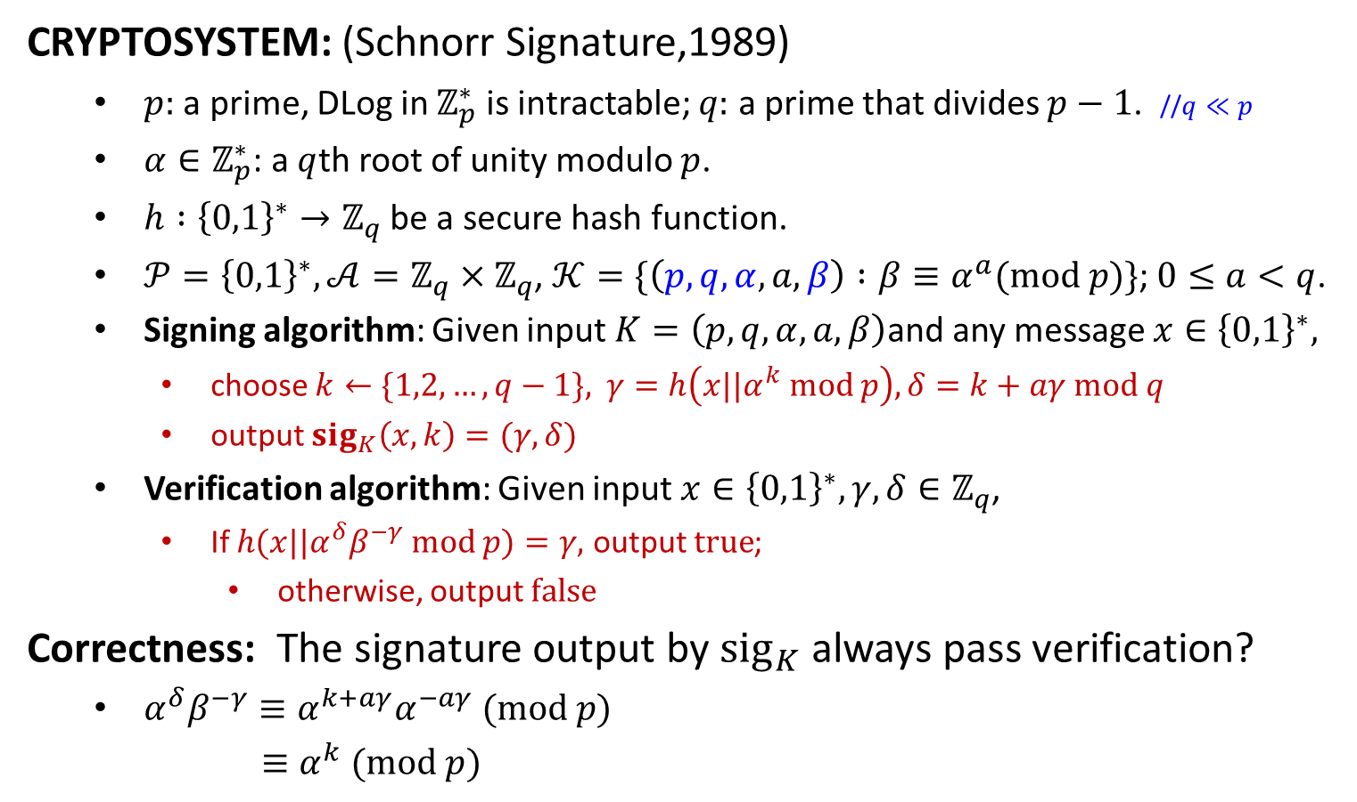
Schnorr Signature
CRYPTOSYSTEM: (Schnorr Signature,1989)
$p:$ a prime, DLog in $ℤ_{p}^{∗}$ is intractable; $q:$ a prime that divides $p−1$. //$q≪p$
$α∈ℤ_{p}^{∗}$: a $q$th root of unity modulo $p$.
$h :{\left\{0,1\right\}}^{∗}→ℤ_{q}$ be a secure hash function.
$𝒫={\left\{0,1\right\}}^{∗}, 𝒜=ℤ_{q}×ℤ_{q}$, $𝒦=\{\left(p,q,α,a,β\right) :β≡α^{a}(mod p)\}$; $0≤a<q$.
Signing algorithm: Given input $K=\left(p,q,α,a,β\right)$and any message $x∈{\left\{0,1\right\}}^{∗},$
choose $k←\{1,2,…,q−1\},$ $γ=h\left(x||α^{k} mod p\right), δ=k+aγ mod q$
output $sig_{K}\left(x,k\right)=(γ,δ)$
Verification algorithm: Given input $x∈{\left\{0,1\right\}}^{∗},γ,δ∈ℤ_{q}$,
If $h(x||α^{δ}β^{−γ} mod p)=γ,$ output $true$;
otherwise, output $false$
Correctness: The signature output by $sig_{K}$ always pass verification?
$α^{δ}β^{−γ}≡α^{k+aγ}α^{−aγ} (mod p)$
$≡α^{k} (mod p)$
Recommended size of primes:
$\left|p\right|=2048$
$\left|q\right|=224$
Security: existentially unforgeable under CMA.
Provable in the random oracle model
Under the Dlog assumption

Slide 11
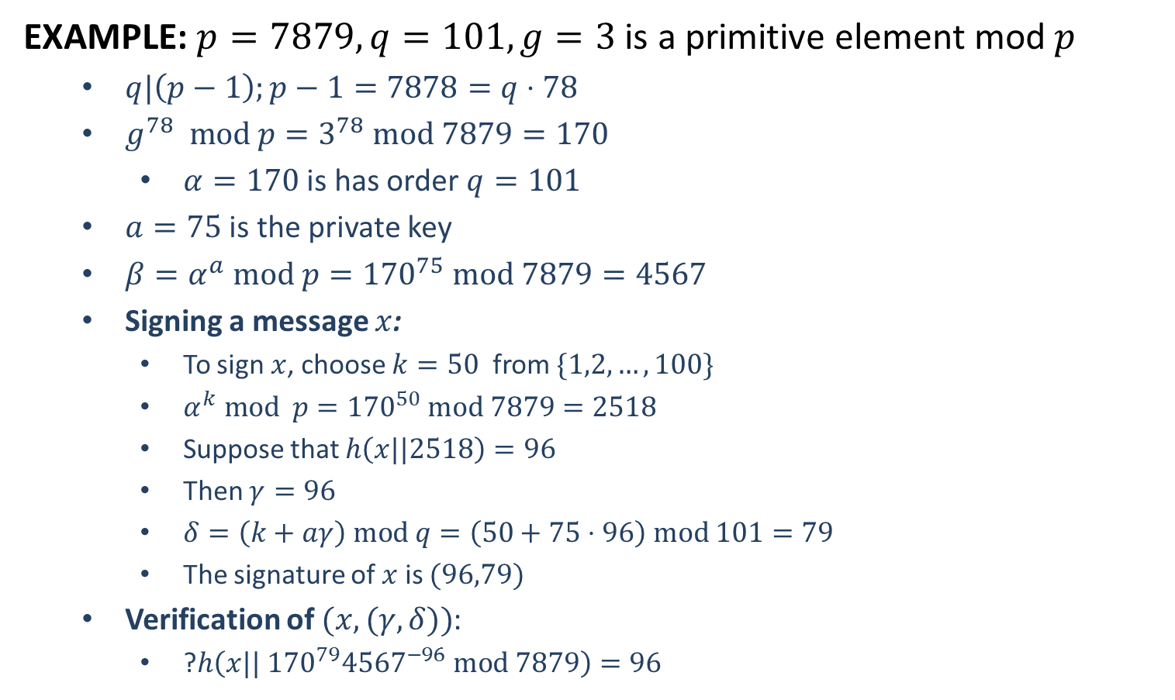
Schnorr Signature
EXAMPLE: $p=7879, q=101, g=3$ is a primitive element mod $p$
$q|\left(p−1\right);p−1=7878=q⋅78$
$g^{78} mod p=3^{78} mod 7879=170$
$α=170$ is has order $q=101$
$a=75$ is the private key
$β=α^{a} mod p={170}^{75} mod 7879=4567$
Signing a message $x$:
To sign $x$, choose $k=50$ from $\{1,2,…,100\}$
$α^{k} mod p={170}^{50} mod 7879=2518$
Suppose that $h\left(x||2518\right)=96$
Then $γ=96$
$δ=\left(k+aγ\right) mod q=\left(50+75⋅96\right) mod 101=79$
The signature of $x$ is $(96,79)$
Verification of $(x,(γ,δ))$:
?$h\left(x|| {170}^{79}{4567}^{−96} mod 7879\right)=96$
$${170}^{79}{4567}^{−96} mod 7879=2518$$

Slide 13

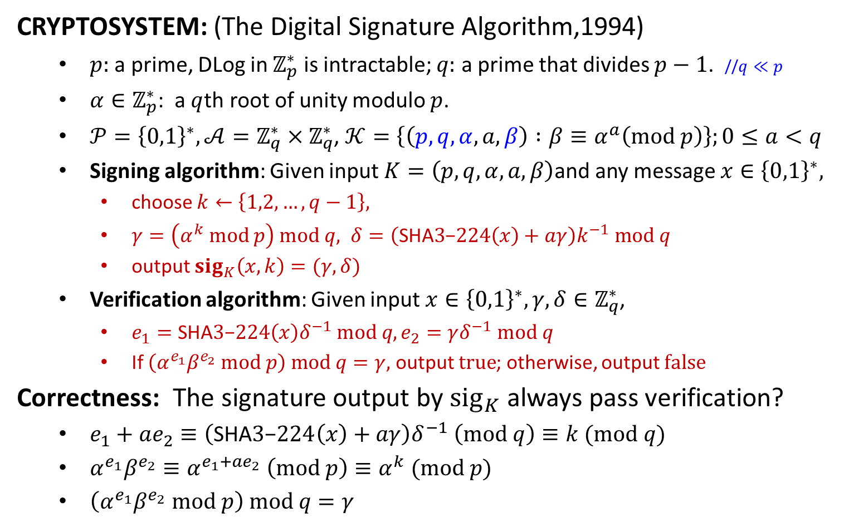
The Digital Signature Algorithm (DSA)
CRYPTOSYSTEM: (The Digital Signature Algorithm,1994)
$p:$ a prime, DLog in $ℤ_{p}^{∗}$ is intractable; $q:$ a prime that divides $p−1$. //$q≪p$
$α∈ℤ_{p}^{∗}$: a $q$th root of unity modulo $p$.
$𝒫={\left\{0,1\right\}}^{∗}, 𝒜=ℤ_{q}^{∗}×ℤ_{q}^{∗}$, $𝒦=\left\{\left(p,q,α,a,β\right) :β≡α^{a}\left(mod p\right)\right\};0≤a<q$
Signing algorithm: Given input $K=\left(p,q,α,a,β\right)$and any message $x∈{\left\{0,1\right\}}^{∗},$
choose $k←\left\{1,2,…,q−1\right\},$
$γ=\left(α^{k} mod p\right) mod q, δ=\left(\text{SHA}3\text{−}224\left(x\right)+aγ\right)k^{−1} mod q$
output $sig_{K}\left(x,k\right)=(γ,δ)$
Verification algorithm: Given input $x∈{\left\{0,1\right\}}^{∗},γ,δ∈ℤ_{q}^{∗}$,
$e_{1}=\text{SHA}3\text{−}224\left(x\right)δ^{−1} mod q, e_{2}=γδ^{−1} mod q$
If $\left(α^{e_{1}}β^{e_{2}} mod p\right) mod q=γ,$ output $true$; otherwise, output $false$
Correctness: The signature output by $sig_{K}$ always pass verification?
$e_{1}+ae_{2}≡\left(\text{SHA}3\text{−}224\left(x\right)+aγ\right)δ^{−1} \left(mod q\right)≡k (mod q)$
$α^{e_{1}}β^{e_{2}}≡α^{e_{1}+ae_{2}} \left(mod p\right)≡α^{k} (mod p)$
$\left(α^{e_{1}}β^{e_{2}} mod p\right) mod q=γ$
$$\left|p\right|=2048; \left|q\right|=224$$
Security: existentially unforgeable under CMA.
Provable in the random oracle model
Under the Dlog assumption

Slide 14
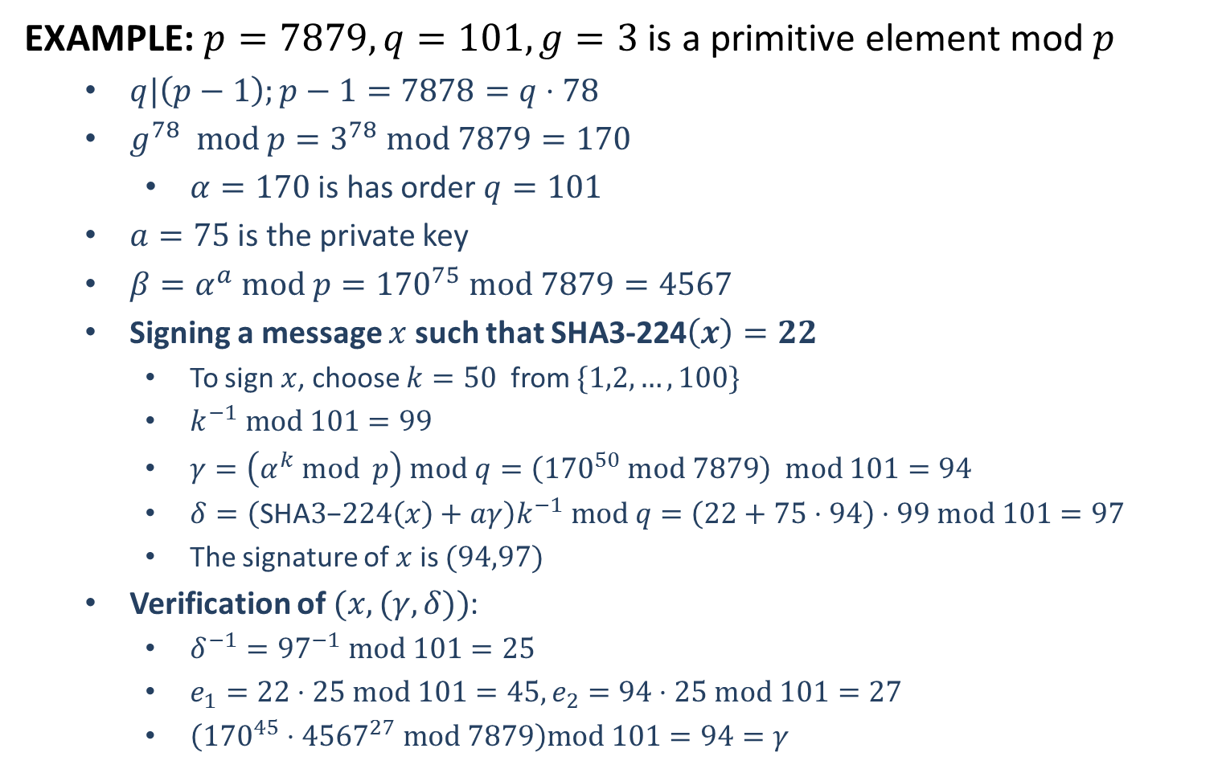
The Digital Signature Algorithm (DSA)
EXAMPLE: $p=7879, q=101, g=3$ is a primitive element mod $p$
$q|\left(p−1\right);p−1=7878=q⋅78$
$g^{78} mod p=3^{78} mod 7879=170$
$α=170$ is has order $q=101$
$a=75$ is the private key
$β=α^{a} mod p={170}^{75} mod 7879=4567$
Signing a message $x$ such that SHA3-224$\left(x\right)=22$
To sign $x$, choose $k=50$ from $\{1,2,…,100\}$
$k^{−1} mod 101=99$
$γ=\left(α^{k} mod p\right) mod q=\left({170}^{50} mod 7879\right) mod 101=94$
$δ=\left(\text{SHA}3\text{−}224\left(x\right)+aγ\right)k^{−1} mod q=\left(22+75⋅94\right)⋅99 mod 101=97$
The signature of $x$ is $(94,97)$
Verification of $(x,(γ,δ))$:
$δ^{−1}={97}^{−1} mod 101=25$
$e_{1}=22⋅25 mod 101=45, e_{2}=94⋅25 mod 101=27$
$\left({170}^{45}⋅{4567}^{27} mod 7879\right)mod 101=94=γ$

